Slide 1
Storage of Data
Where data will be stored
On-board data storage
Cloud data storage
Etc
What database will we be using
Assuming we use MySQL, we must detail a schema for the database and give sample queries that will be used to process and query the data

Slide 2
Data Storage
The primary database will be a mongodb database hosted on the AWS server. A secondary database will exist on the Rasberry Pi. This will contain enough data to be able to operate the pill box for a period of time if the connection to the server fails.

Slide 3
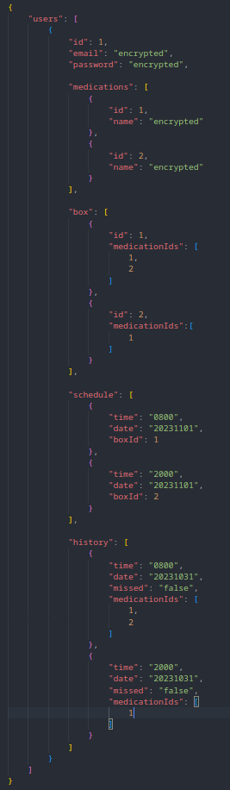
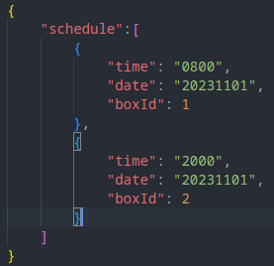
Data Storage – Example Entries
User Entry on server
Schedule stored on Rasberry Pi

Slide 4
Data Gathering
include detail about the frequency with which each sensor can record a value and how the sensors work
What types of data are we gathering
How much data are we gathering
Why do we need to gather this data

Slide 5
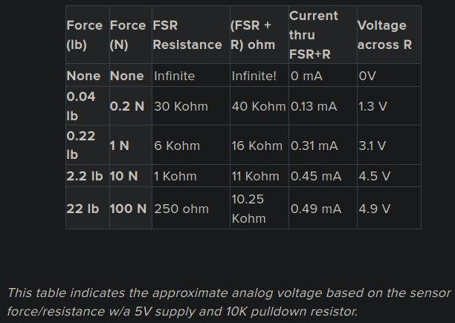
Data Gathering - Switches
Force Sensitive Resistor
- Analog data
- Values between 0mV – 5000mV
- 0mV reprensents no force
- 5000mV represents a high force
- This will tell us if a box is empty or has pills inside
Micro Switch
- 0v across an open switch
- 5v across a closed switch
- This will tell us if a box is open or closed

Slide 6
Data Gathering - User
User Data
- User email
- Password
- This will be used to create a user account
Medication
- Medication details
- This will be used to assist in refilling the boxes and to create medication histories
Time
- To send notifications
- To see when a box was opened
- To record missed doeses

Slide 7
Data Processing
Where is the data processed
What is the end result of data processing
How CRON fits into the process
List the cron jobs that will be run

Slide 8
Data Processing
Sensor data will be processed locally.
Notifications and medication history will be process on the AWS server.
Notifications will be sent to the users’ devices by AWS server.
Medication data will be edited on the web client before being sent to AWS server.
The data will be processed to record if medication was taking on time, a dose was missed and if the medication box will require a refill.
A CRON job will be running to restart the program if it has stopped.

Slide 9
Security of Transmitted Data
e.g Using POST instead of GET
Make sure the data can’t be intercepted with something like wireshark

Slide 10
Security of Data at Rest
Store on a secure cloud service
Maybe wipe the onboard data once it has been sent, as it is only meant to be a backup

Slide 11
Data Security
Data will be transferred between the device, server and web/mobile client by HTTPS.
HTTP GET will only be used to retrieved data.
HTTP POST or PUT will be used to enter or update data.
Sensitive data, such as medication information, will only be stored as encrypted data.
End to end encryption will be used to ensure only the user as access to sensitive data in a decrypted form.
The database will be stored on a AWS server.
Only times to take medication and which specific box it is stored in will be stored locally.
If sensor data is required to be stored locally due to an inability to communicate with the server, it will be wiped after the connection is reestablished and the updates are applied.

